Slide 1
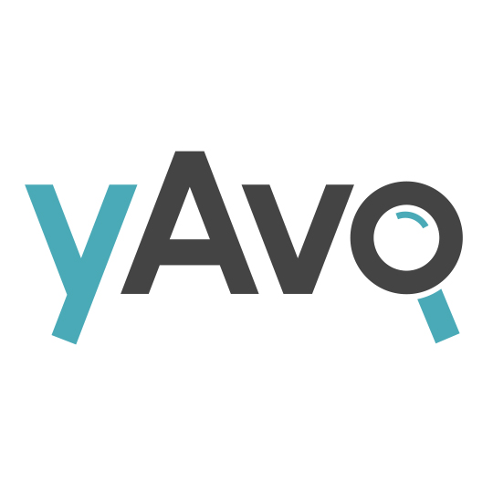
Moldovan Online Legal Empowerment Platform Alexander Turcan Turcan Cazac Law Firm www.yAvo.md Jun 2018

Slide 2
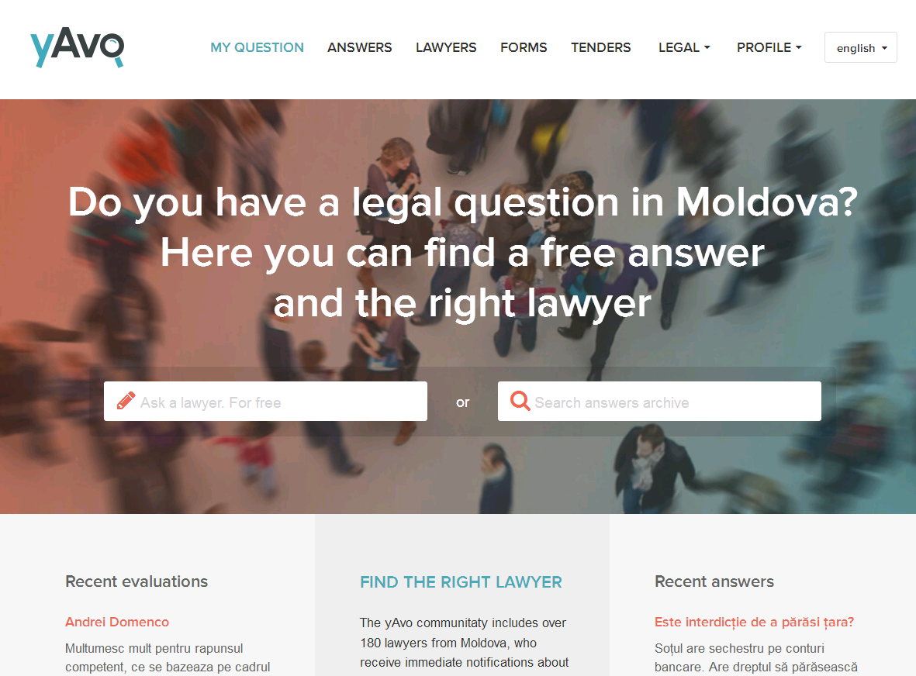

Slide 3
Timeline (4 yrs)
Jun 2014 – idea start time, followed by two years of implementation
Jun 2016 – platform open to accept registrations from lawyers
Jul 2016 – first question posted online by the general public
Feb 2018 – reached 5,000 free legal answers
Jun 2018 – will reach 7,000 free legal answers

Slide 4
Main Facts
CURRENT AUDIENCE:
12,000 users/month – according to Google Analytics
Average session duration – 3+ minutes
A good average session duration is 2-3 minutes.
Average page views per session – 3+ pages
The unofficial industry standard is 2 pages per session.
LEGAL PARTICIPANTS:
200 lawyers
and growing; best growth – during online promotions
OUTPUT FROM PARTICIPANTS:
15-20 answers per day – during paid online promotions
5% of all legal answers – from paralegals

Slide 5
Participants
200 lawyers, including:
90 advocates and trainees
40 in-house lawyers
40 law students
30 community paralegals
Few notaries and court executors (bailiffs)

Slide 6
Advocates

Slide 7
No Attorney-Client Relationship
Users are not ‘clients’
Anonymous questions by users are encouraged
User profile details are not visible
Users can ask follow-up questions
Users who have no access to internet ask via relatives (e.g. grandchildren) or via community paralegals
Personal data found in questions are redacted/moderated
Terms and conditions clearly stipulate that online answers are not legal advice; users are encouraged to engage counsel when seeking legal certainty
Questions and answers are not confidential and can be viewed online by anyone
No formal quality control in place; users are warned that answers can be incomplete or wrong

Slide 8
Email Notifications
Platform moderators are notified by email of new questions submitted by users
Lawyers are notified when moderators publish questions in their respective practice area
Users are notified when a lawyer posts an answer
All parties to a yAvo conversation are notified of new posts/comments
Users are invited to evaluate the answers received from various lawyers

Slide 9
Advantages
Very easy to use by individuals
Website use consumes minimum internet traffic due to simple graphics
Answers provided by real lawyers with professional profiles and contact information; not by anonymous respondents
Many lawyers available to take follow-up calls, emails or meetings; even paid follow-up work
There are always lawyers willing to donate their legal knowledge online (as opposed to willing to constantly meet people in their offices in a traditional way for free legal advice)
Online communication makes interactions more efficient, facilitates asking of questions on various legal issues (as opposed to not asking them at all, or visiting a law office and being asked to pay a fee for often basic advice) and simplifies the process of answering by not having to sit in a meeting with a person in search of basic legal answers
Moderation of questions by lawyers – to disallow infrequent pranks, repetitive questions, to redact (reduce) questions

Slide 10
Law Students
40 law students
Some are very active
Random monitoring from other lawyers
Corrections via additional answers by other lawyers or via offline communications with students
Excellent training tool for many active students interested in legal careers
Good addition to a law grad resume

Slide 11
Law Students (2)

Slide 12
Paralegals
Moldova has about 40 community paralegals (grassroots legal advocates) working in villages and helping vulnerable groups deal with basic legal needs
The Moldovan paralegals are regulated by the Moldovan National Legal Aid Office
Many paralegals use yAvo.md as a source of legal information to help on their pending cases
Most paralegals have created advisory profiles on yAvo; and some are quite active

Slide 13
Paralegals (2)

Slide 14
Free Downloads
Some free legal forms will be made available from time to time.
Screenshot shows form upload date and frequency of downloads of:
Legal services contract form
Child support claim form
Divorce filing form + child support claim

Slide 15
Future
Grow the platform
The basic legal Q&A functionality will remain always free
Add new functional features
Add provision of pre-packaged low-cost legal services available at reasonable flat fees
In collaboration with local leading law firms, implement similar platforms in other countries where unavailable

Slide 16
yAvo.Law
Visit https://yavo.law
It shows an example of how the yAvo project can be replicated in other countries

Slide 17
yavo.law/country
What is required to start a yAvo project in a new country?
Good reputation among the local legal community and the national bar
Strong interest in legal empowerment and pro bono
Ability to source funding for online promotions (grant or sponsor funding should be available for such purposes)
Ability to convince first 50 lawyers (plus few paralegals and law students) to join the platform before the launch of online promotions
Daily commitment to moderate questions posted on the platform by the general public (about 1 hr per day; can be managed by legal interns or legal secretaries; grant or sponsor funding could be available for such purposes)

Slide 18
yavo.law/language
Today the platform is available in English, Russian and Romanian
Other languages can be easily added with the help of a local country partner

Slide 19
Supporter
Online promotion, creation of multilingual interface, other functional improvements (e.g. tags) were supported by:
Department of Justice and Human Rights
Soros-Moldova Foundation
“Shared Framework on Legal Empowerment in Moldova” project
Funding from Open Society Foundations

Slide 20
Global recognition
www.yAvo.md is the only Eastern European pro bono initiative shortlisted for the Local Pro Bono Impact Award by the PILnet Global Pro Bono Forum, October 2017
A total of six projects from Argentina, Moldova, Australia, Spain, South Africa and the UK were shortlisted for the global pro bono award.
Details here: http://www.probonoforum.org/europe/local-impact-for-global-change-2017-awards/

