Slide 1
Case study I: The paralegal movement in the Philippines Legal Empowerment Leadership Course 2-7 December 2018, Budapest, Hungary
MARLON J. MANUEL

Slide 2
Which is the Philippine flag?
A –
B –
C –
D –
Notes:
A - Paraguay
C – Czech Republic
D – Laos PDR

Slide 3
What is today’s temperature in Manila?
A – 20
B – 24
C – 32
D – 38

Slide 4
How many islands are there in the Philippines?
A – 7,107 islands
B – 1,707 islands
C – 710 islands
D – 107 islands

Slide 5
What is the total population of the Philippines?
A – 30 Million
B – 50 Million
C – 75 Million
D – 110 Million

Slide 6
Who is the current President of the Philippines?
A – Arroyo
B – Estrada
C – Aquino
D – Duterte

Slide 7
What is the poverty incidence in the Philippines?
A – 25 %
B – 21 %
C – 19 %
D – 10 %

Slide 8
How many Filipinos are billionaires?
A – 0
B – 5
C – 9
D – 12

Slide 9
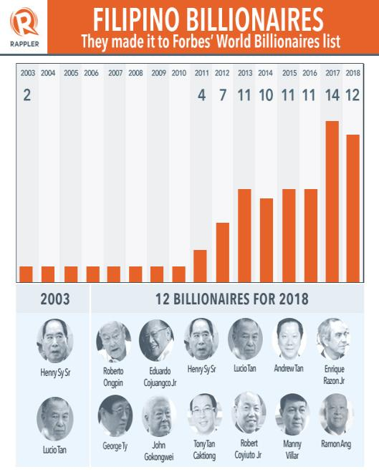

Slide 10
“the bottom 20 percent of families have a share of about 6 percent of the total income in the country; whereas the upper 20% of income distribution have a share of nearly 50% of total income”
- 2012 First Semester Official Poverty Statistics of the Philippines,
National Statistical Coordination Board

Slide 11
“The total income of the top 20% of families is approximately 8 times
of the total income of the bottom 20% of families in the first semester
of 2006, 2009, and 2012.”
2012 First Semester Official Poverty Statistics of the Philippines,
National Statistical coordination Board

Slide 12
What is the system of government in the Philippines?
A – Federal
Parliamentary
B – Unitary
Presidential
C – Federal Monarchy
D – Federal
Presidential

Slide 13
What countries are the former colonial powers of the Philippines?
A – Netherlands and
Portugal
B – United Kingdom
and Germany
C – Spain and United
States
D – China and Russia

Slide 14
How many civil society organizations are there in the Philippines?
A – more than 250,000
B – more than 100,000
C – more than 50,000
D – more than 10,000

Slide 15
How many trial court judges are there in the Philippines?
A – 4,400
B – 3,300
C – 2,200
D – 1,100

Slide 16
How many lawyers are there in the Philippines?
A – more than 10,000
B – more than 20,000
C – more than 30,000
D – more than 40,000

Slide 17
What is the language of the law and the courts in the Philippines?
A – Filipino
B – English
C – Filipino and other
major local languages
D – English, Filipino,
and other major local
languages

Slide 18
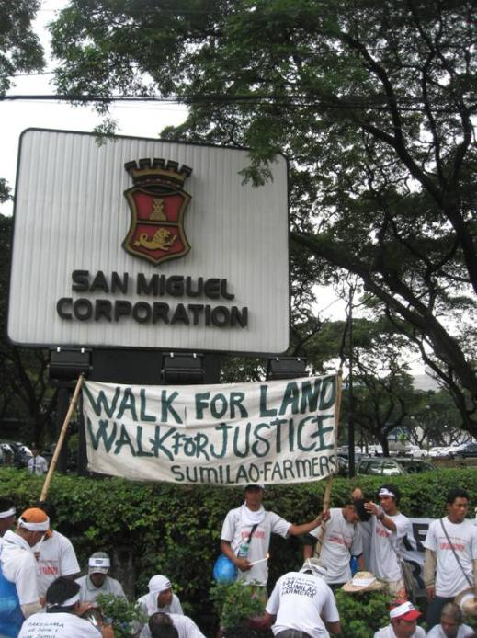

Slide 19
55 farmers 1,700 Kilometers 30 - 40 kilometers every day October to December 2007 144 hectare land 165 families
Metro Manila
Sumilao,
Bukidnon

Slide 21
1997
October 1997 - 28-day hunger strike
President Fidel V. Ramos issued a “Win-Win Resolution”
Supreme Court invalidated the “win-win” formula

Slide 22
2007
The property remained an agricultural land. No development happened.
The landowner sold the land to corporate giant San Miguel Corporation.
The farmers filed a case and made another claim for the land.
The government denied the farmers’ claim.

Slide 24
Epilogue
December 18, 2007 - the Office of the President issued an order cancelling the conversion permit.
March 29, 2008 - the farmers entered into an agreement with San Miguel.
2009 – the Philippine Congress passed a law which extended the period of implementation (and the budget) of the agrarian reform program.
Today, the farmers operate and manage the farm as a social enterprise, through a farmers cooperative.

Slide 28
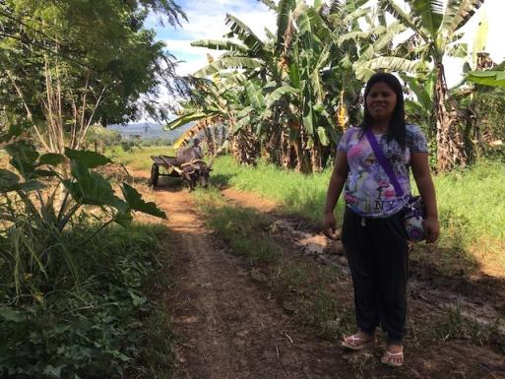
The Sumilao farmers, a decade after they marched for their rights https://www.rappler.com/move-ph/185345-sumilao-farmers-decade-after-march
DECADE AFTER. The lives of the Sumilao farmers have changed in so many ways 10 years after they fought for their rights.

Slide 29
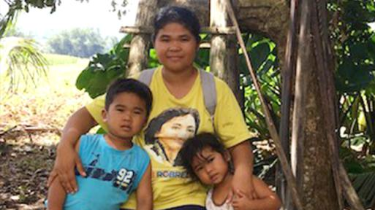
The Sumilao farmers, a decade after they marched for their rights https://www.rappler.com/move-ph/185345-sumilao-farmers-decade-after-march
Bajekjek Orquillas
YOUNGEST FARMER. Bajekjek Orquillas is the youngest farmer who joined the walk.
Photo by Ana Santos

Slide 30
Rene Peñas
Gunned down on June 5, 2009 by unidentified persons

Slide 31
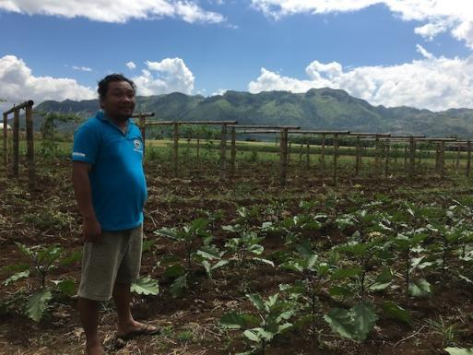
The Sumilao farmers, a decade after they marched for their rights https://www.rappler.com/move-ph/185345-sumilao-farmers-decade-after-march
Noland Penas
A BETTER LIFE. Noland Penas used to have no land of his own, but now that he already does, life has become so much better. Photo by Ana Santos
DECADE AFTER. The lives of the Sumilao farmers have changed in so many ways 10 years after they fought for their rights.

Slide 34
Martin Luther King, Jr.
“But those who adhere to the method of nonviolent, direct action recognize that legislation and court orders tend only to declare rights –
they can never thoroughly deliver them.
Only when the people themselves begin to act are rights on paper given lifeblood. Life is breathed into a judicial decision by the persistent exercise of legal rights until they become usual
and ordinary in human experience.”
(The case Against “Tokenism,”
New York Times Magazine, 5 August 1962)

Slide 35
PART 2

Slide 36
Group Discussion
What is the strategic role
of legal empowerment programs -- and of paralegals -- in the period or situation described?
(WHAT MUST BE DONE?)
Are there similarities
with events/situations in your country’s history?

Slide 37
Group 1
The President has ruled the country for two decades under martial law.
Leaders of the political opposition and activists are arrested without court orders, and detained for prolonged periods without formal charges.
Thousands become victims of human rights violations (torture, extra-judicial killings, enforced disappearances, etc.).

Slide 38
1972-1986 – Marcos dictatorship
The President ruled the country under martial law.
Leaders of the political opposition and activists were arrested without court orders, and detained for prolonged periods without formal charges.
Thousands became victims of human rights violations (torture, extra-judicial killings, enforced disappearances, etc.).

Slide 39
Group 2
After twenty years in power, the dictator was removed from office through a peaceful uprising.
The new president convened a commission which drafted a new Constitution.
The Constitution contained many progressive provisions, including provisions that recognized the role of people’s organizations, and those mandating the Legislative (Congress) to enact social justice laws.

Slide 40
1986-1990 – New government; New constitution
After twenty years in power, the dictator was removed from office through a peaceful uprising.
The new president convened a commission which drafted a new Constitution.
The Constitution contained many progressive provisions, including provisions that recognized the role of people’s organizations, and those mandating the Legislative (Congress) to enact social justice laws.

Slide 41
Group 3
With the mandate of the 1987 Constitution, the Congress enacted many progressive social justice laws.
The enactment of laws led to the implementation of many social justice programs that address different issues – housing, agrarian reform, violence against women, etc.

Slide 42
1987-1997 – Social Justice Legislation
With the mandate of the 1987 Constitution, the Congress enacted many progressive social justice laws.
The enactment of laws led to the implementation of many social justice programs that address different issues.

Slide 43
Group 4
A law for local governments became effective.
The law provides for mechanisms for people’s participation in land use planning, development planning, local budget preparation, local policy formulation.
Many local government officials were receptive to civil society inputs and participation.

Slide 44
1992-2001 – Local Government Strengthening
A law for local governments became effective.
The law provides for mechanisms for people’s participation in land use planning, development planning, local budget preparation, local policy formulation.
Many local government officials were receptive to civil society inputs and participation.

Slide 45
Group 5
The Supreme Court initiated a comprehensive judicial reform program, which attracted multi-stakeholder support (including from many donor agencies).
The Supreme Court conducted many activities (including consultations with various sectors) with the objective of addressing access to justice, and other issues of the justice system.

Slide 46
2001-2010 – Judicial Reform
The Supreme Court initiated a comprehensive judicial reform program, which attracted multi-stakeholder support (including from many donor agencies).
The Supreme Court conducted many activities (including consultations with various sectors) with the objective of addressing access to justice, and other issues of the justice system.

Slide 47
Group 6
There has been a growing number of issues concerning destruction of natural resources and communities adversely affected by corporate activities (especially mining).
The Supreme Court issued special rules for environmental cases, which provide remedies for communities affected by activities that have adverse impact on the environment.

Slide 48
2010-2016 – Focus on Corporations
There has been a growing number of issues concerning destruction of natural resources and communities adversely affected by corporate activities (especially mining).
The Supreme Court issued special rules for environmental cases, which provide remedies for communities affected by activities that have adverse impact on the environment.

Slide 49
Group 7
A populist President was elected.
Immediately after the President started his term, he launched a campaign against illegal drugs (“War on Drugs”) and ordered the police to start a very aggressive operations against suspected drug users and suppliers.
Thousands of “drug personalities” were killed, allegedly in legitimate police operations.

Slide 50
2016-Present – Duterte’s War on Drugs
A populist President was elected.
Immediately after the President started his term, he launched a campaign against illegal drugs (“War on Drugs”) and ordered the police to start a very aggressive operations against suspected drug users and suppliers.
Thousands of “drug personalities” were killed, allegedly in legitimate police operations.

Slide 51
Group 8
Early in his term, the President has shown strong authoritarian tendencies.
Using a violent incident involving an armed group, he placed one third of the country under martial law, and threatened to place the entire country under martial law if needed.
He plans to amend the Constitution, changing the system of government from unitary to federal, and opening up certain industries, and land ownership, to foreign corporations.
He has publicly attacked the Chief Justice and the Ombudsman, and the Commission on Human Rights. Eventually, the Chief Justice was removed from office.

Slide 52
2017 – Return of Authoritarianism
Early in his term, the President has shown strong authoritarian tendencies.
Using a violent incident involving an armed group, he placed one third of the country under martial law, and threatened to place the entire country under martial law if needed.
He plans to amend the Constitution, changing the system of government from unitary to federal, and opening up certain industries, and land ownership, to foreign corporations.
He has publicly attacked the Chief Justice and the Ombudsman, and the Commission on Human Rights. Eventually, the Chief Justice was removed from office.

Slide 53
“When it is obvious that
the goals cannot be reached,
don't adjust the goals,
adjust the action steps.”
- Confucious

